Slide 1
Establishing Container Trust at Scale
KubeCon Austin 2017
By Tim Mackey – Black Duck Software

Slide 2
Review: Container Build and Deployment Process

Slide 3




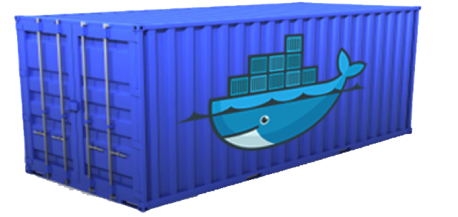

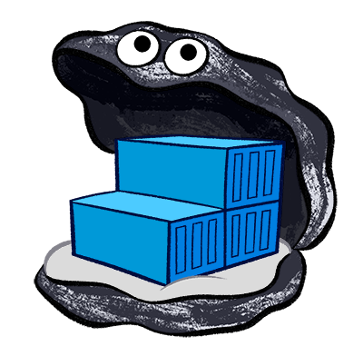


Container Image Build Process
Binary Sources
SCM Trigger
Registry
webapp:1.0.1
webapp:latest
webapp@sha256:123456
Git

Slide 4
How Images are Created – Core Components of a Dockerfile
FROM centos:centos7
MAINTAINER Black Duck Hub Team
RUN yum -y update-minimal --security --sec-severity=Important --sec-severity=Critical --setopt=tsflags=nodocs && yum clean all && chmod -x /bin/sh
ARG bds_ver
ARG LASTCOMMIT
ARG BUILDTIME
ARG BUILD
ENV APP_HOME=/scan.cli-${bds_ver}
ENV PATH=${APP_HOME}/bin:${JAVA_HOME}/bin:${PATH}
COPY ./output/ose_scanner /ose_scanner
COPY ./hub_scanner/scan.cli/scan.cli-${bds_ver} /scan.cli-${bds_ver}
COPY ./LICENSE /LICENSE
COPY ./LICENSE /licenses/
COPY ./help.1 /help.1
LABEL name="Black Duck OpsSight for OpenShift Scanner"
ENTRYPOINT [ "/ose_scanner" ]
EXPOSE 9036

Slide 5
How Images are Created – Docker Engine Cache
[root@localhost ose-scanner]# docker images
REPOSITORY TAG IMAGE ID CREATED SIZE
hub_ose_controller 4.2.0 363bfa6e7974 15 hours ago 53.98 MB
hub_ose_arbiter 4.2.0 15adc3ecc6ab 16 hours ago 53.38 MB
hub_ose_scanner 4.2.0 395dfd09d6d7 16 hours ago 447 MB
docker.io/centos centos7 196e0ce0c9fb 6 weeks ago 196.6 MB

Slide 6
How Images are Created – Image Layer History
[root@localhost ose-scanner]# docker history hub_ose_scanner:4.2.0
IMAGE CREATED CREATED BY SIZE COMMENT
395dfd09d6d7 16 hours ago /bin/sh -c #(nop) EXPOSE 9036/tcp 0 B
6ccb88892a15 16 hours ago /bin/sh -c #(nop) ENTRYPOINT ["/ose_scanner" 0 B
604fcdb13b57 16 hours ago /bin/sh -c #(nop) LABEL name=Black Duck OpsS 0 B
5bf60b767227 2 days ago /bin/sh -c #(nop) COPY file:0319ebe1148b5cefa 682 B
fe23aeab7fcc 2 days ago /bin/sh -c #(nop) COPY file:e822182ba43798ba0 11.36 kB
9cdc179735ad 2 days ago /bin/sh -c #(nop) COPY file:e822182ba43798ba0 11.36 kB
57bd5e62be14 2 days ago /bin/sh -c #(nop) COPY dir:d9dc3b531575096c83 241.6 MB
a1cb8fd37a68 2 days ago /bin/sh -c #(nop) COPY file:98c69c969ee05b51b 6.14 MB
13855a218a3e 7 days ago /bin/sh -c #(nop) ENV PATH=/scan.cli-4.2.0/b 0 B
885efab8f9b5 7 days ago /bin/sh -c #(nop) ENV APP_HOME=/scan.cli-4.2 0 B
1ed791e999b5 7 days ago /bin/sh -c #(nop) ARG BUILD 0 B
9dcb95a5ceb4 7 days ago /bin/sh -c #(nop) ARG BUILDTIME 0 B
8ada27a4da06 7 days ago /bin/sh -c #(nop) ARG LASTCOMMIT 0 B
7461b836791f 7 days ago /bin/sh -c #(nop) ARG bds_ver 0 B
4020be54fb0f 7 days ago /bin/sh -c yum -y update-minimal --security - 2.632 MB
208a012b6fe4 7 days ago /bin/sh -c #(nop) MAINTAINER Black Duck Hub 0 B
196e0ce0c9fb 6 weeks ago /bin/sh -c #(nop) CMD ["/bin/bash"] 0 B
<missing> 6 weeks ago /bin/sh -c #(nop) LABEL name=CentOS Base Ima 0 B
<missing> 6 weeks ago /bin/sh -c #(nop) ADD file:1ed4d1a29d09a636dd 196.6 MB

Slide 7
How Images are Created – Image Layer Cache Impacts Build
[root@localhost ose-scanner]# docker images --all
REPOSITORY TAG IMAGE ID CREATED SIZE
hub_ose_scanner 4.2.0 395dfd09d6d7 17 hours ago 447 MB
<none> <none> 6ccb88892a15 17 hours ago 447 MB
<none> <none> 604fcdb13b57 17 hours ago 447 MB
<none> <none> 5bf60b767227 2 days ago 447 MB
<none> <none> fe23aeab7fcc 2 days ago 447 MB
<none> <none> 9cdc179735ad 2 days ago 447 MB
<none> <none> 57bd5e62be14 2 days ago 447 MB
<none> <none> a1cb8fd37a68 2 days ago 205.4 MB
<none> <none> 13855a218a3e 7 days ago 199.3 MB
<none> <none> 885efab8f9b5 7 days ago 199.3 MB
<none> <none> 1ed791e999b5 7 days ago 199.3 MB
<none> <none> 9dcb95a5ceb4 7 days ago 199.3 MB
<none> <none> 8ada27a4da06 7 days ago 199.3 MB
<none> <none> 7461b836791f 7 days ago 199.3 MB
<none> <none> 4020be54fb0f 7 days ago 199.3 MB
<none> <none> 208a012b6fe4 7 days ago 196.6 MB
docker.io/centos centos7 196e0ce0c9fb 6 weeks ago 196.6 MB
[root@localhost ose-scanner]# docker history hub_ose_scanner:4.2.0
IMAGE CREATED CREATED BY SIZE COMMENT
395dfd09d6d7 16 hours ago /bin/sh -c #(nop) EXPOSE 9036/tcp 0 B
6ccb88892a15 16 hours ago /bin/sh -c #(nop) ENTRYPOINT ["/ose_scanner" 0 B
604fcdb13b57 16 hours ago /bin/sh -c #(nop) LABEL name=Black Duck OpsS 0 B
5bf60b767227 2 days ago /bin/sh -c #(nop) COPY file:0319ebe1148b5cefa 682 B
fe23aeab7fcc 2 days ago /bin/sh -c #(nop) COPY file:e822182ba43798ba0 11.36 kB
9cdc179735ad 2 days ago /bin/sh -c #(nop) COPY file:e822182ba43798ba0 11.36 kB
57bd5e62be14 2 days ago /bin/sh -c #(nop) COPY dir:d9dc3b531575096c83 241.6 MB
a1cb8fd37a68 2 days ago /bin/sh -c #(nop) COPY file:98c69c969ee05b51b 6.14 MB
13855a218a3e 7 days ago /bin/sh -c #(nop) ENV PATH=/scan.cli-4.2.0/b 0 B
885efab8f9b5 7 days ago /bin/sh -c #(nop) ENV APP_HOME=/scan.cli-4.2 0 B
1ed791e999b5 7 days ago /bin/sh -c #(nop) ARG BUILD 0 B
9dcb95a5ceb4 7 days ago /bin/sh -c #(nop) ARG BUILDTIME 0 B
8ada27a4da06 7 days ago /bin/sh -c #(nop) ARG LASTCOMMIT 0 B
7461b836791f 7 days ago /bin/sh -c #(nop) ARG bds_ver 0 B
4020be54fb0f 7 days ago /bin/sh -c yum -y update-minimal --security - 2.632 MB
208a012b6fe4 7 days ago /bin/sh -c #(nop) MAINTAINER Black Duck Hub 0 B
196e0ce0c9fb 6 weeks ago /bin/sh -c #(nop) CMD ["/bin/bash"] 0 B
<missing> 6 weeks ago /bin/sh -c #(nop) LABEL name=CentOS Base Ima 0 B
<missing> 6 weeks ago /bin/sh -c #(nop) ADD file:1ed4d1a29d09a636dd 196.6 MB

Slide 8
Image Consistency and Pull Specifications
Pull and run “latest”
Scale to 2 replicas
Pull and run tag “1.0.1”
Scale to 2 replicas
Pull and run pull spec “sha256:12345”
Scale to 2 replicas
Delete tag “1.0.1” in registry
Scale “1.0.1” to 3 replicas
Add node 2
Down node 1
Cluster Node 1
“latest”
“latest”
1.0.1
1.0.1
Sha256:12345
Sha256:12345
1.0.1
Cluster Node 2
“latest”
“latest”
Sha256:12345
Sha256:12345

Slide 9
Deployments and Triggers
Primary Objective: Facilitate Application Deployment
Abstracts Replication Controllers and Pods from Users
DeploymentConfig
Defines the conditions for a new deployment
Configuration and Image changes supported
Defines deployment strategy
Rolling, Recreate, Blue/Green, A/B, Custom
Requires “readiness” probes for pods
Rollback via DeploymentConfigRollback
kind: "DeploymentConfig"
apiVersion: "v1"
metadata:
name: "frontend"
spec:
template:
metadata:
labels:
name: "frontend"
spec:
containers:
- name: "helloworld"
image: "openshift/helloworld"
triggers:
- type: "ConfigChange"
- type: "ImageChange"
imageChangeParams:
automatic: true
containerNames:
- "helloworld"
from:
kind: "ImageStreamTag"
name: “helloworld:latest"
strategy:
type: "Rolling"

Slide 10
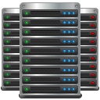

OpenShift Source To Image and Build Pipelines
Build Pipelines
Registry
Security Scan
Staging Tests
Registry
SCM Trigger
Deployment Trigger
Git

Slide 11

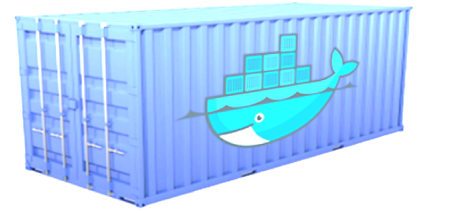

Patching Containers – A/B Testing Using DeploymentConfig
Binary Sources
SCM Trigger
Registry
Deployment Trigger
Git

Slide 12
Security Driven Development and Deployment
Developers are empowered with security information
Clear security driven release policies exist
Trusted components are used as dependencies
CI processes incorporate security testing
Binary artifacts are only created when release policies are met
Releasable binaries are digitally signed
Container images are built from trusted base images
Authors of trusted base images follow security driven development
Produced images are stored in trusted container registries
Containers are only deployed from trusted registries
What can go wrong?

Slide 13
Moving to Scale
Aka – The Real World Beckons

Slide 14
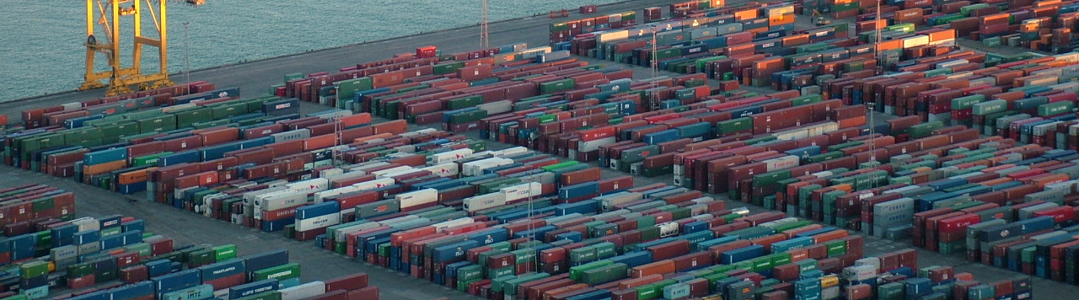
What is “Scale”?
“You’ll know it when you get there”
Change management matters
Deployments are subject to governance regs
Service delivery includes statements like “HA”, “DR” and “SLA”

Slide 15
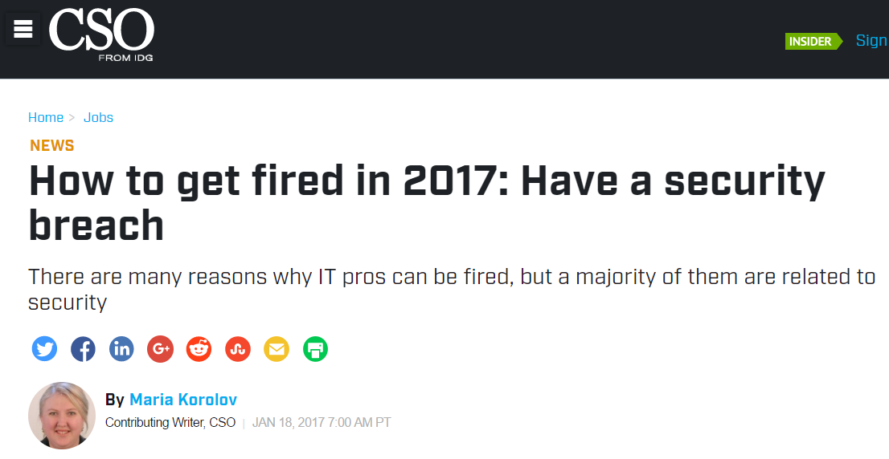
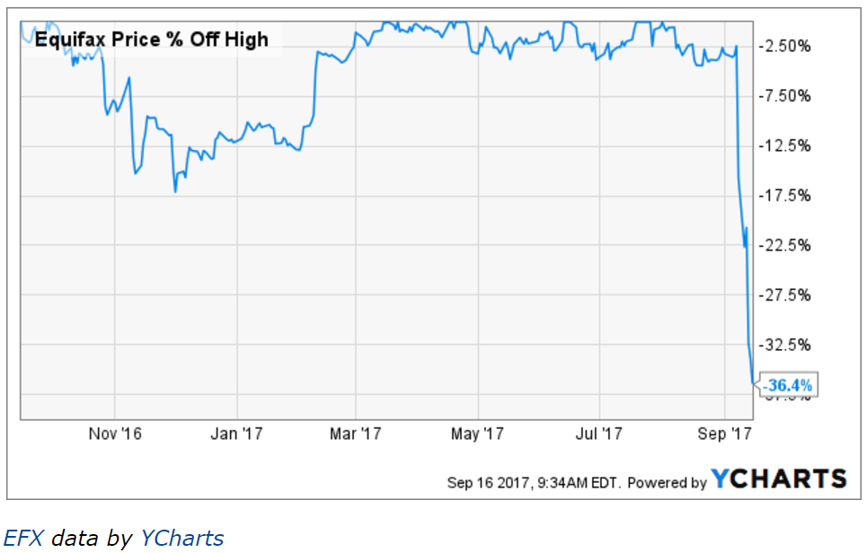
Data Breaches are Serious Business
Average cost of data breach: $7.35 Million
Lost business: $4.03 Million
Average time to identify and contain a breach: 206 days
Source: 2017 Cost of Data Breach Study – Ponemon Insitute

Slide 16
Question Everything and Continually Evaluate Trust
Where does your base image actually come from?
What is the health of that base image?
You’re updating it at build time, but from what cache?
You trust your build servers, but who controls them?
Is there any way a foreign container can start in your environment?
Who has rights to modify container images?
What happens if base image registry goes away?
What happens if base image tag goes away?
What happens if an update mirror goes down?
When a security disclosure happens what’s the process to determine impact?
How are images being updated and deployed in the face of new security disclosures?
My brain hurts and this is a lot of work!

Slide 17
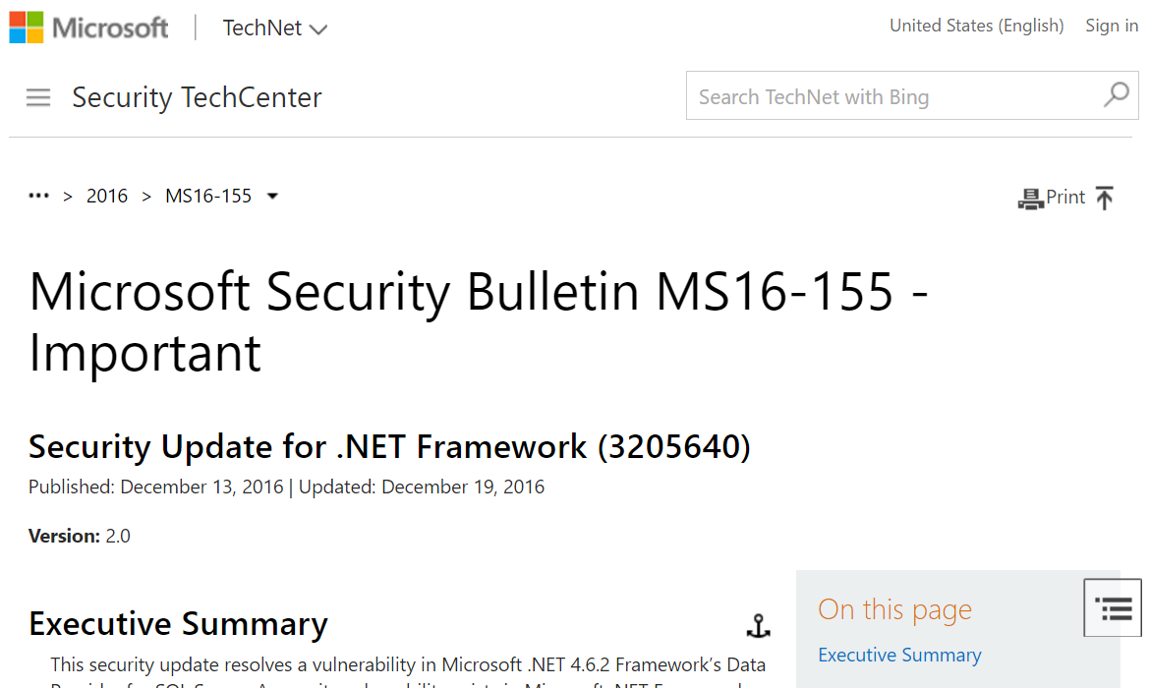
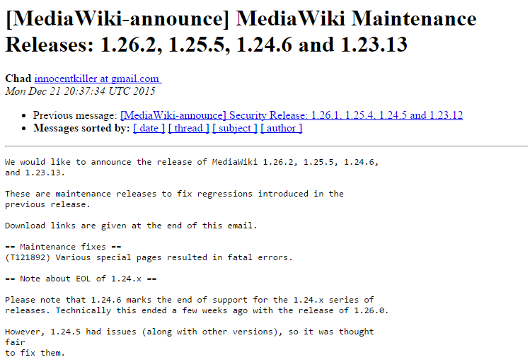
Proprietary Software Rules Aren’t Open Source
CLOSED SOURCE COMMERCIAL CODE
Traditional procurement process
ALERTING AND NOTIFICATION INFRASTRUCTURE
Support available through eol
Staffed with SECURITY RESEARCHERS
REGULAR PATCH UPDATES
DEDICATED SUPPORT TEAM WITH SLA
OPEN SOURCE CODE
Ad-hoc adoption model
Monitor newsfeeds yourself
Eol may create deadend
“community”-based code analysis
No standard patching mechanism
Ultimately, you are responsible
Notes:
https://www.cesg.gov.uk/guidance/open-source-software-%E2%80%93-exploring-risk-good-practice-guide-38
If you’re using commercial software, the vendor is responsible for best practice deployment guidance, the notification of any security vulnerabilities and ultimately patches and workarounds for disclosed vulnerabilities. This is part of the deliverable they provide in return for their license fee.
If you’re using open source software, that process becomes partly your responsibility. To illustrate the level of information you have to work with, let’s look at a media-wiki maintenance release from December 2015.
“various special pages resulted in fata errors” – this clearly is something which needs resolution, but which pages? How do you test?
“1.24.6 marks the end of support for 1.24.x” – this is good to know, but I hope it was published elsewhere.
“However, 1.24.5 had issues (along with other versions) so it was thought fair to fix them” – This is a good thing, but can we expect this treatment in the future? From the title, we also have a fix for 1.23.x, but what other versions?

Slide 18
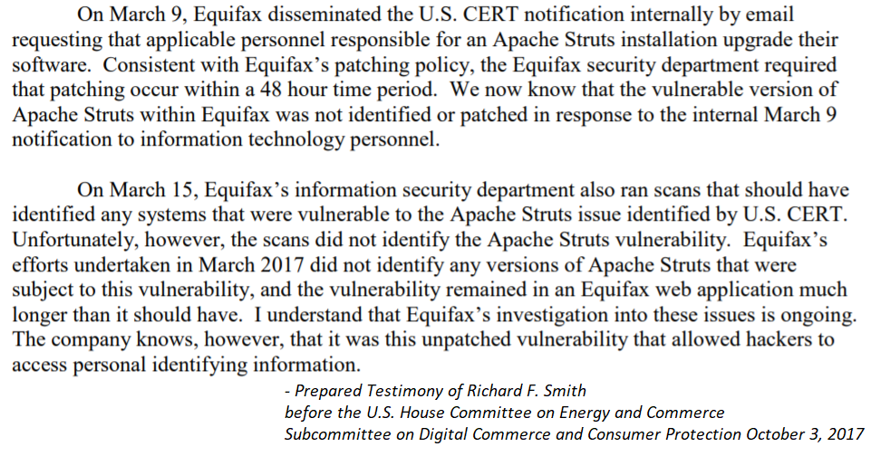



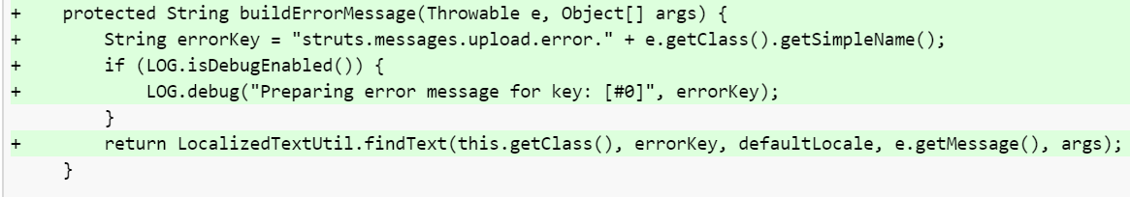
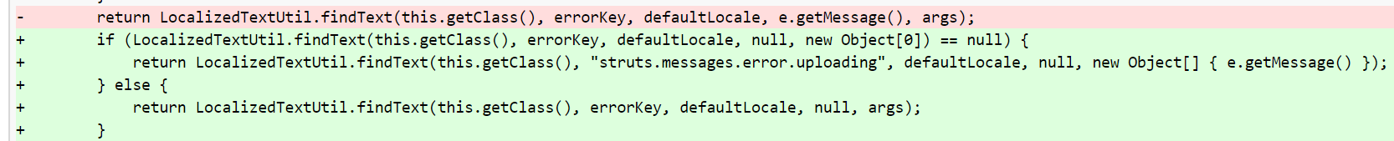
The Tale of CVE-2017-5638 and Equifax
August 2012
November 2012
May 2016
March 6 2017
March 7 2017
March 14 2017
May 13 2017
July 29 2017
Code Bug Introduced
Struts 2.3 Released
Struts 2.5 Released
Patches Available
Disclosure Published
NVD Details
Hacks Successful
Hacks Discovered
1649 Days
7 Days
144 Days

Slide 19












Security Analysis Isn't Only SAST/IAST/DAST
Static, Injection and Dynamic Analysis
Discover common security patterns
Challenged by nuanced bugs
Focuses on your code; not upstream
Vulnerability Analysis
Identifies vulnerable dependencies
3000+ disclosures in 2015
4000+ disclosures in 2016
13,000+ disclosures through Nov 2017
Most vulnerabilities found by researchers
All possible security vulnerabilities

Slide 20
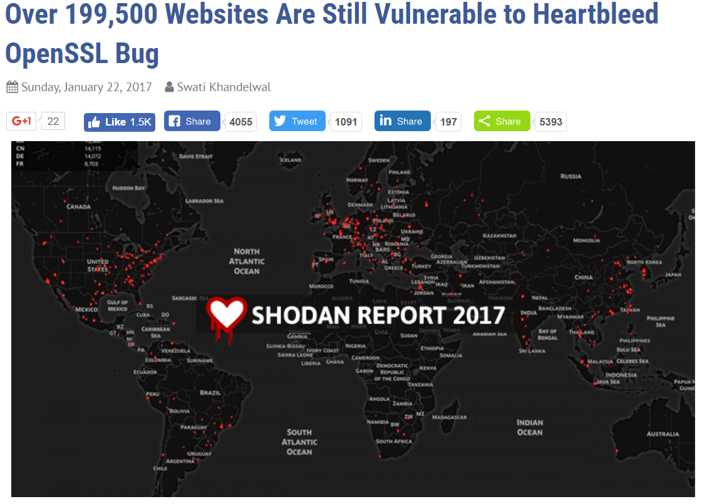
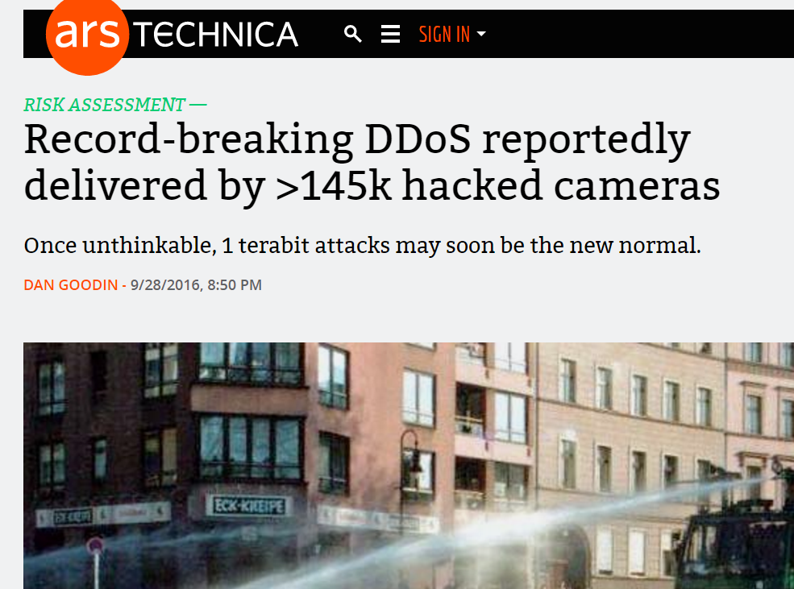
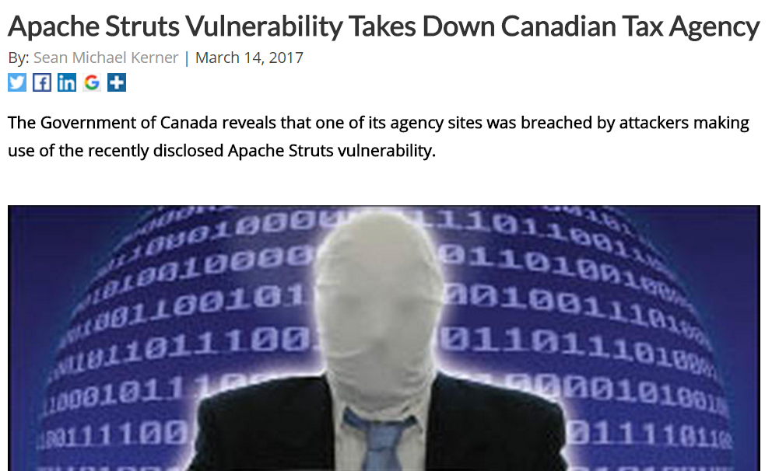
Don’t Give Attackers Opportunities
OpenSSH (CVE-2004-1653): AllowTCPForwarding creates open IoT proxy
Heartbleed: Why in 2017?
Apache Struts (CVE-2017-5638): Vulnerability response time matters

Slide 21
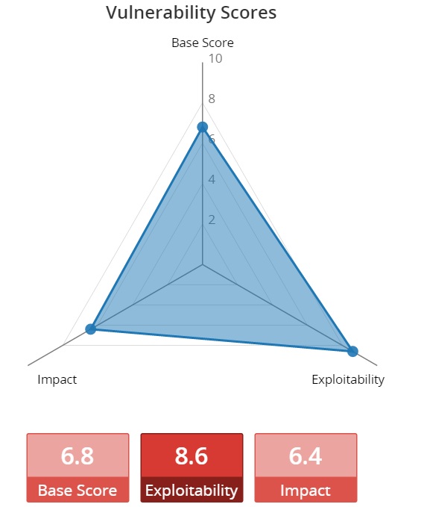
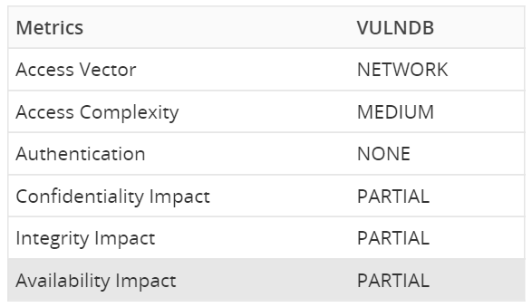
Focus on Factors Impacting Risk
Use of vulnerable open source components
What are my dependencies and where are they coming from?
Is component a fork or dependency?
How is component linked?
Impact of Point in Time Decisions
Can you differentiate between “stable” and “dead”?
Is there a significant change set in your future?
API versioning
Security response process for project
Commit velocity and contributors

Slide 22
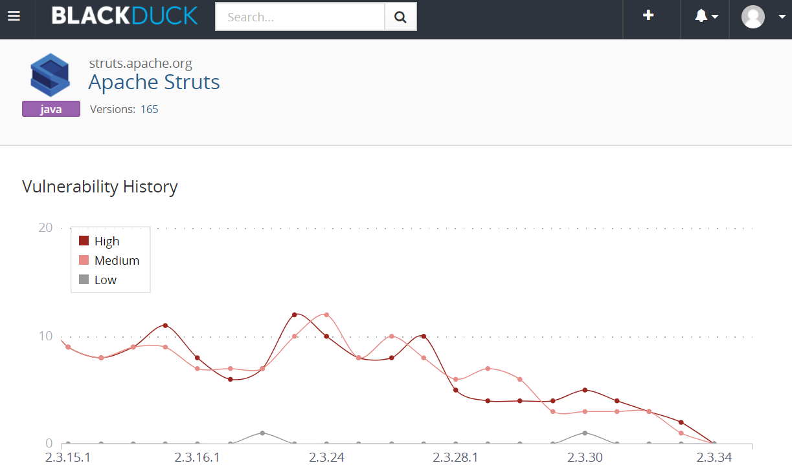
We Don’t Patch Containers – But Patches Matter
Patch version worse
Patch version worse
Patch version worse

Slide 23
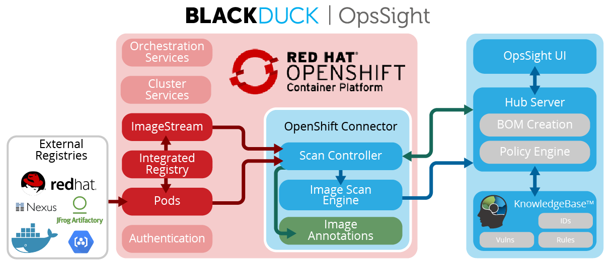



Integrated Registry
OpsSight for OpenShift Connector
Hub Scan Controller
Component Identification
Hub Scan Engine
External Registries
Image Annotation
Black Duck KnowledgeBase
Hub Notifications
Policy Engine
ImageStream Events

Slide 24
Sources of Truth
Identify vulnerable images
Identify vulnerable pods
Maintain a security source of truth

Slide 25

Layer Container Security For Maximum Impact
Secure Platform with Red Hat OpenShift Container Platform and Atomic Host
Administer DISA STIG: CVE, CCE, CPE, CVSS, OVAL, and XCCDF
OVAL formatted patch definitions for Red Hat products
Scan all container images in an OpenShift deployment as the are created, modified and used
Provide visibility into open source components regardless of source
Annotate images and image streams with vulnerability information
Annotations automatically updated as new disclosures occur – without the need for rescan

Slide 26





Managing Open Source Security Requires End-End Visibility
INVENTORY
MAP
IDENTIFY
MANAGE
ALERT
Open Source Components
To Known Vulnerabilities
Open Source Risks
Open Source Governance Policies
For New Vulnerabilities
Automation and workflow
Integration with DevOps tools and processes

Slide 27
Thank You!

